Slide 1
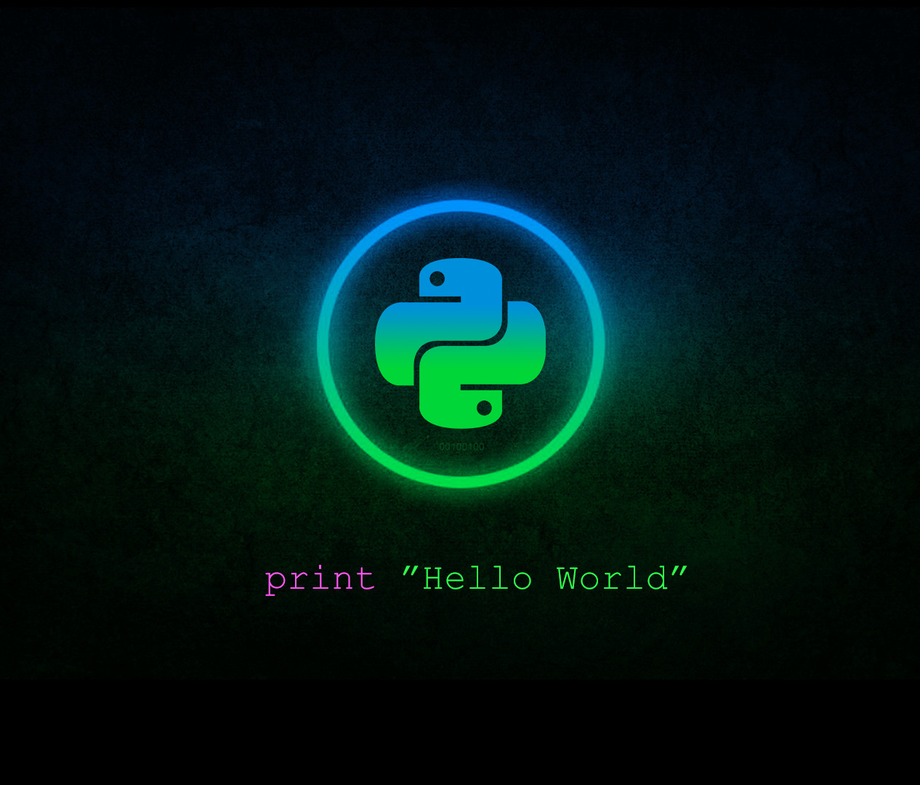
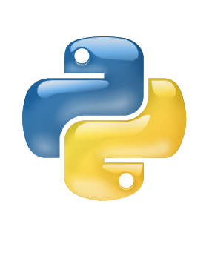


Introduction to Python
Class
IX
Lab 1
Supported by
Powered By

Slide 2

Are we talking about snake ?
Ops ! No
Supported by
Powered By

Slide 3
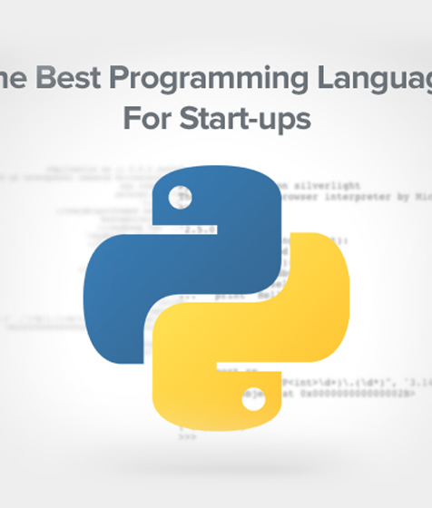
What is python
The best programming language for start ups
interpreted high-level programming language for general-purpose programming
Created by Guido van Rossum and first released in 1991
Named according to the comedy group Monty Python Flying Circus
Supported by
Powered By

Slide 4

Why python?
It’s Dynamic and easiest language on earth
Python is an open source platform
General Purpose Language
Beginner Friendly
Community Support
Best career opportunities
Supported by
Powered By

Slide 5

What can you do using python?
Web Programming
GUI Programming
Network Programming
System Programming
Big Data
Data Mining
Data Analysis
Artificial Intelligence
Supported by
Powered By

Slide 6

Web Programming
Supported by
Powered By

Slide 7
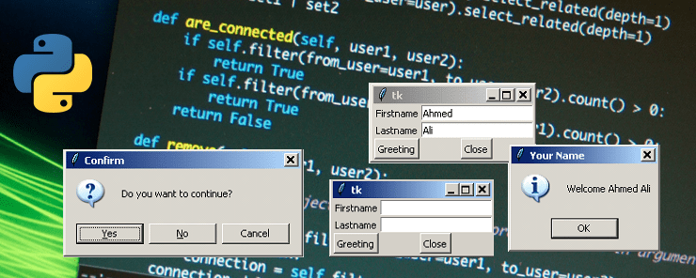
GUI Programming
Supported by
Powered By

Slide 8
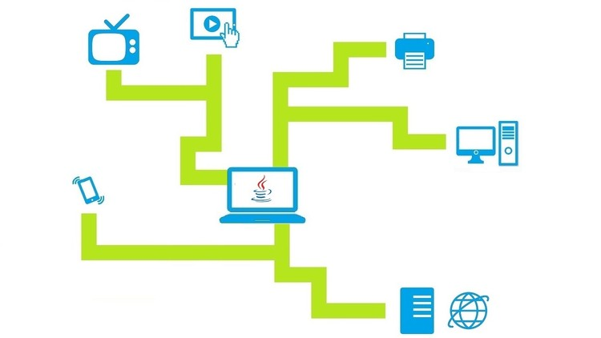
Network Programming
Supported by
Powered By

Slide 9
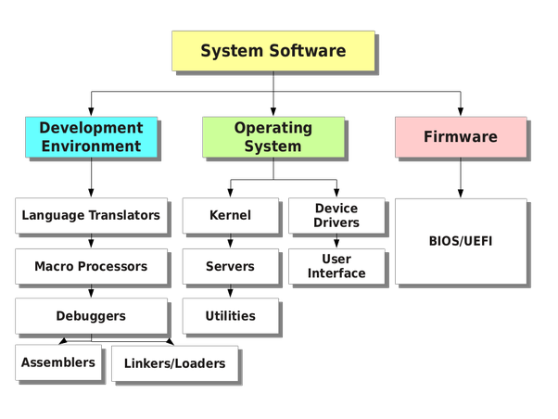
System Programming
Supported by
Powered By

Slide 10
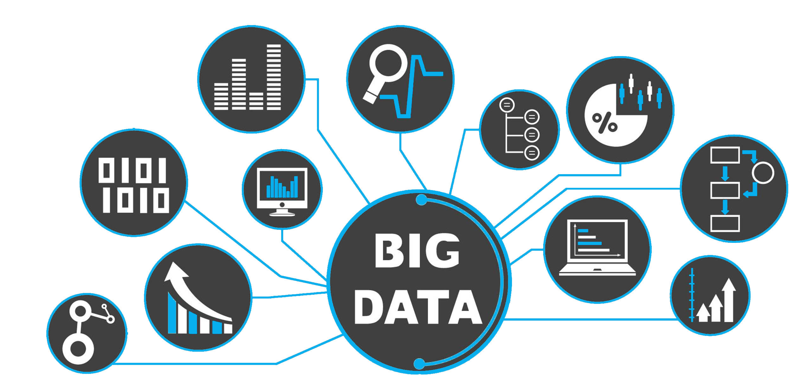
Big Data
Supported by
Powered By

Slide 11
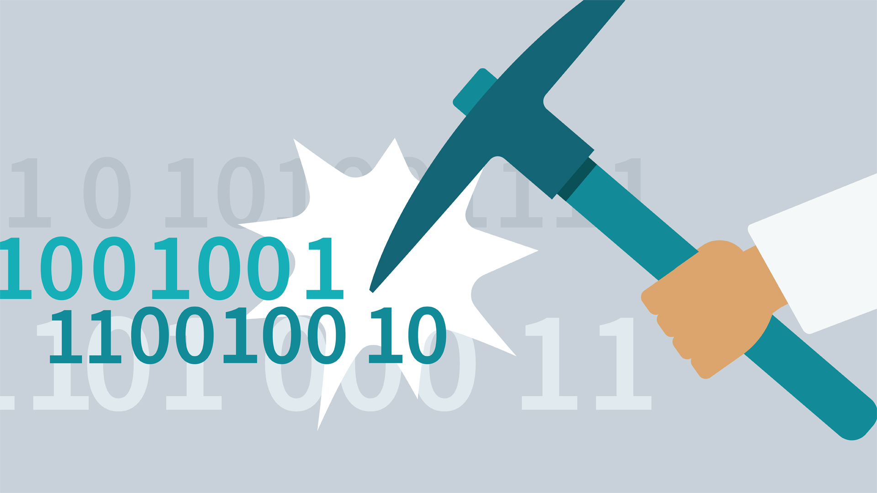
Data Mining
Supported by
Powered By

Slide 12
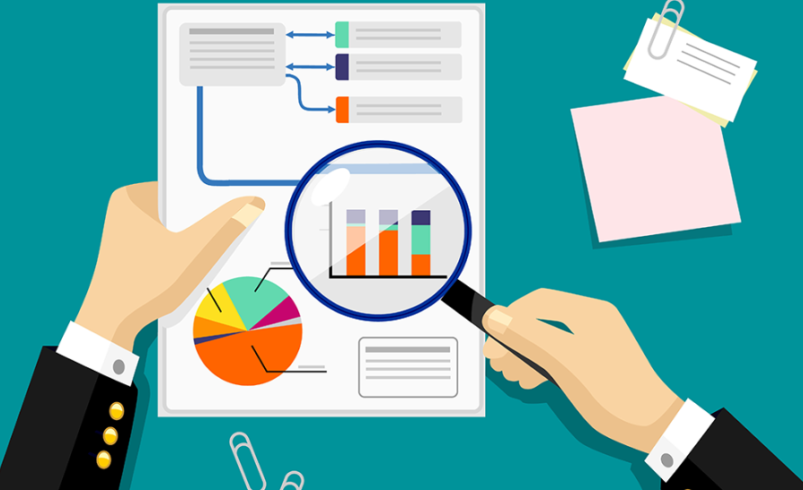
Data Analysis
Supported by
Powered By

Slide 13
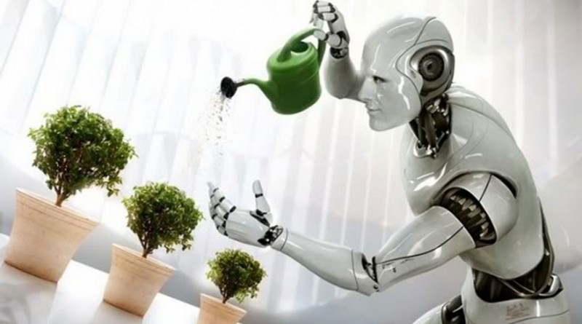
Artificial Intelligence
Supported by
Powered By

Slide 14

Machine Learning
Supported by
Powered By

Slide 15
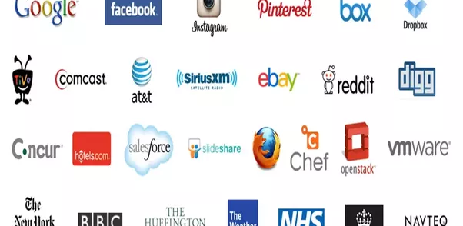
Who uses python?
Supported by
Powered By

Slide 16

Thank You!
You’ll dive into practical python programming from the next lab

